Slide 1
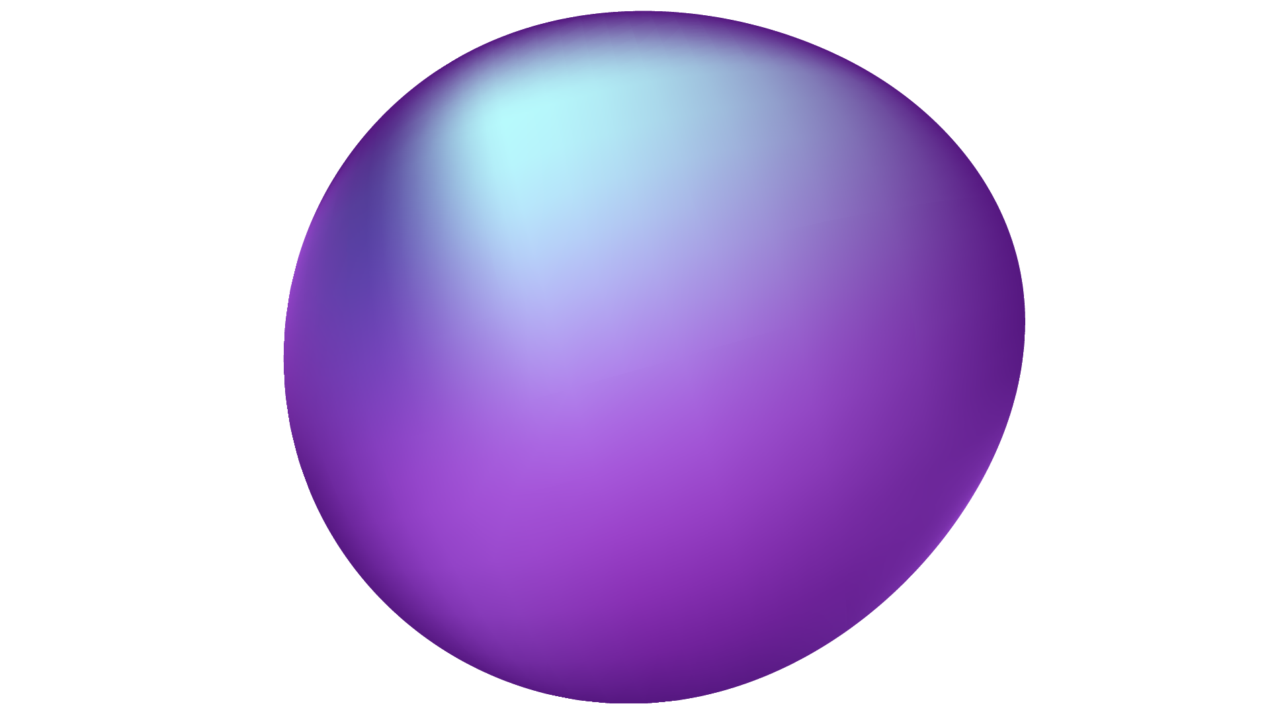


Machine Learning
Notes:
Welcome address
What we’ll cover today:
What is AI/ML
Day to day applications of AI/ML
Supervised and unsupervised learning
Algorithms associated with these 2 types of learning

Slide 2
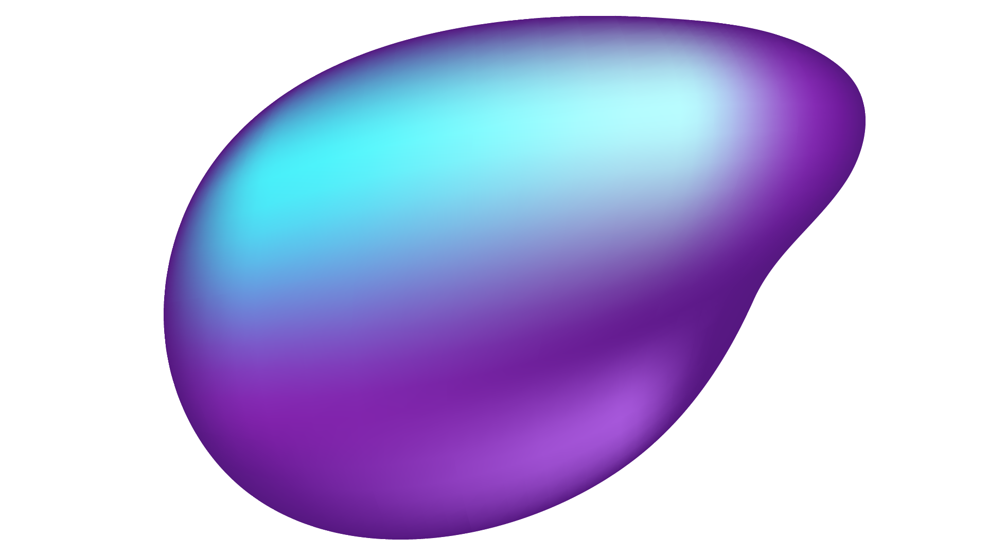
What is machine learning?
A branch of AI that is focused on building systems/algorithms that can learn from data and generalize its trends to unseen data and thus perform tasks without explicit instructions
Able to make more informed decisions over time
Think of it as a function where some input is converted into an output based upon patterns/structures observed based on training data
Notes:
Question: Who here already has some experience in ML, who has no idea
So we’re gonna discuss a lot of technical terms today but let start off with a high level overview of what machine learning actually does and what are some day to day applications
And more importantly why we use machine learning in the first place

Slide 3
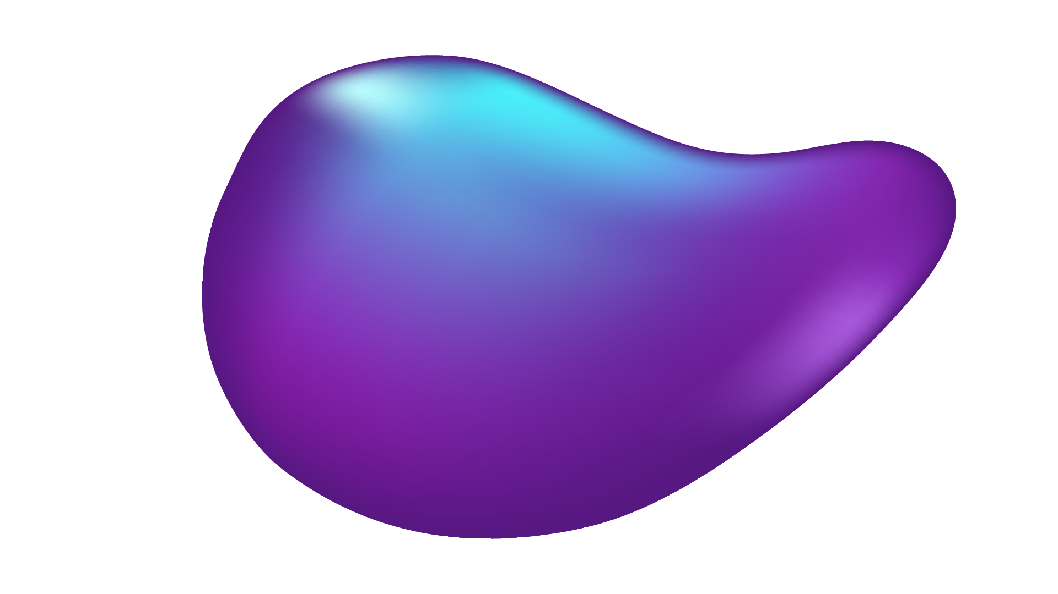
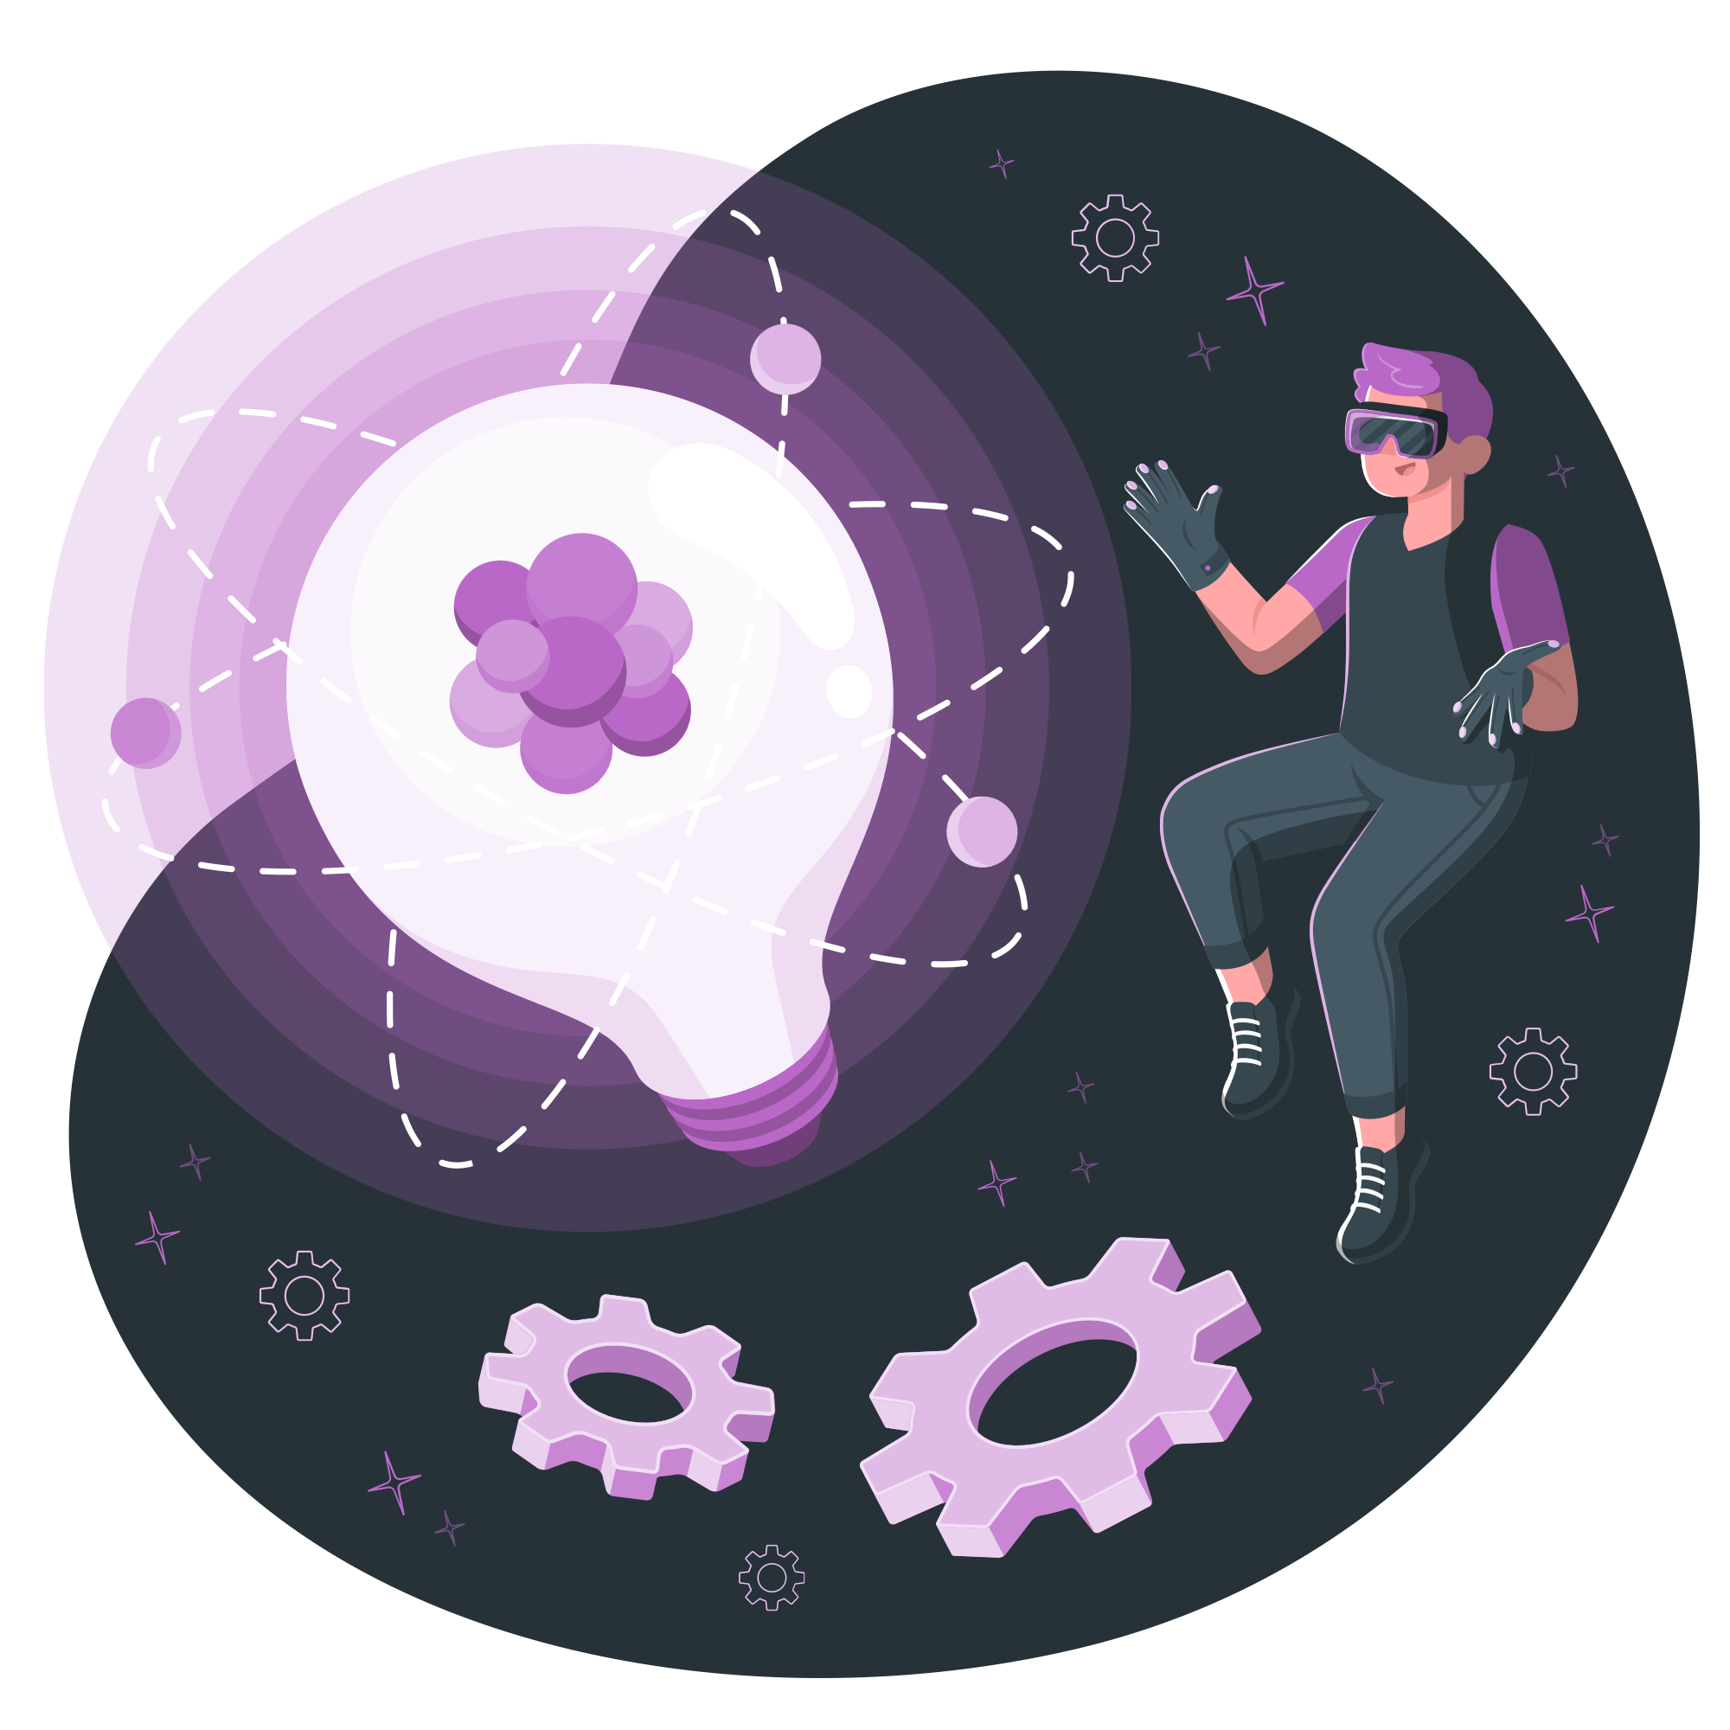
Why do we use machine learning?
- Human expertise is not available
- Humans cannot explain their expertise as a set of rules (speech / image recognition)
- Many solutions need to adapt automatically (models must be customised i.e recommendation system)
Applications Include: Pattern recognition, trend prediction

Slide 4
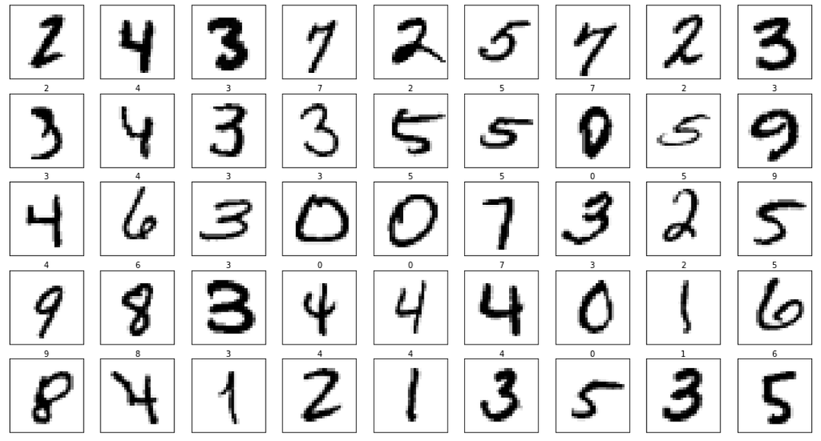
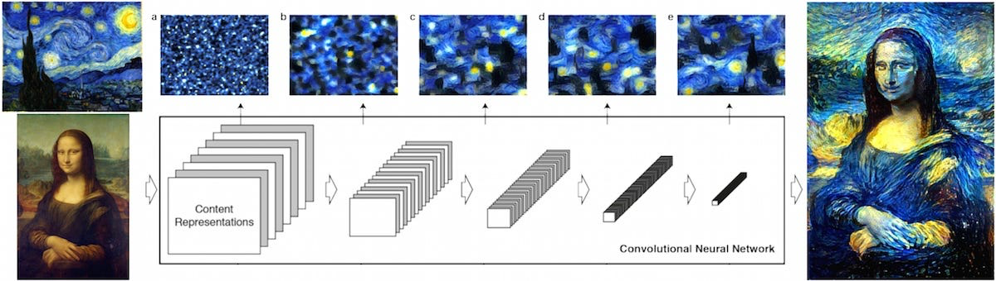
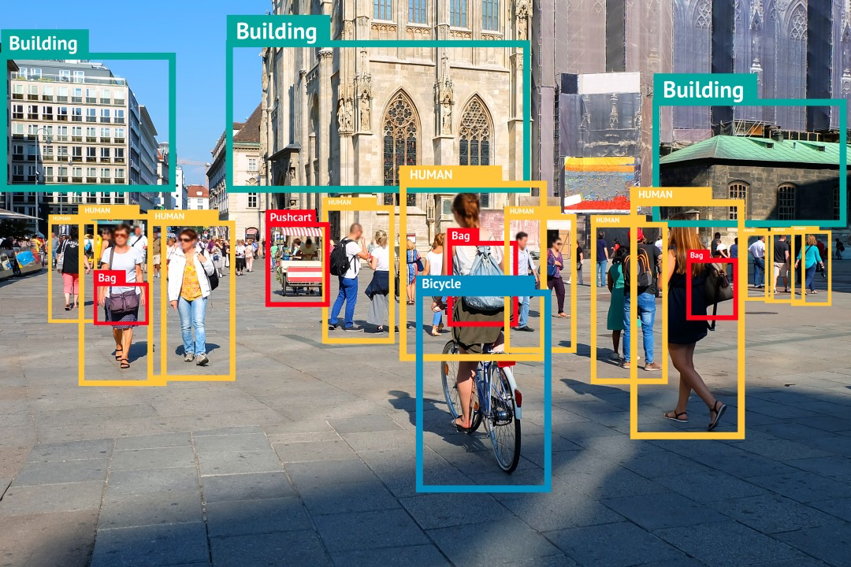
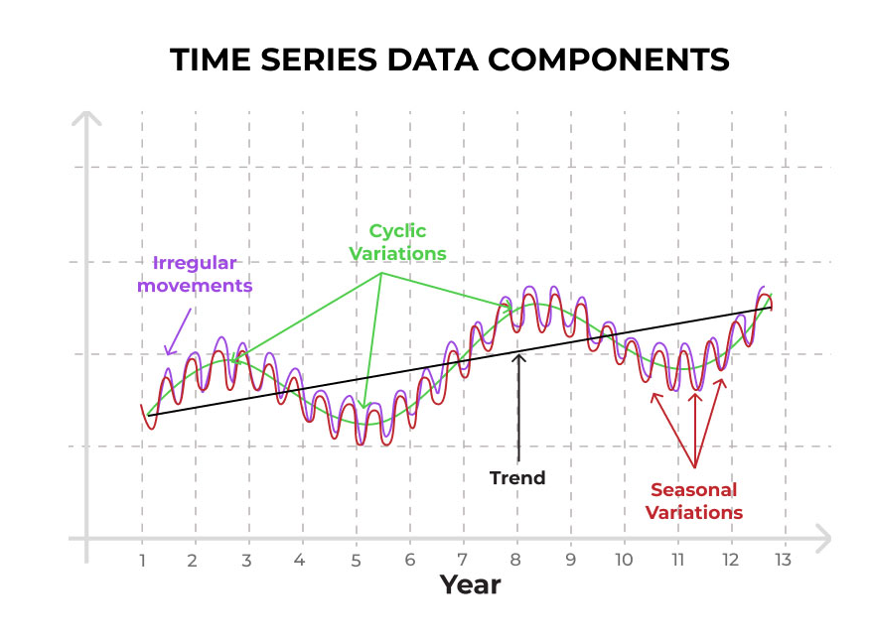
Notes:
Explain what each application is and what algorithm in machine learning it relates to
Applications of ML: Social media feed

Slide 5
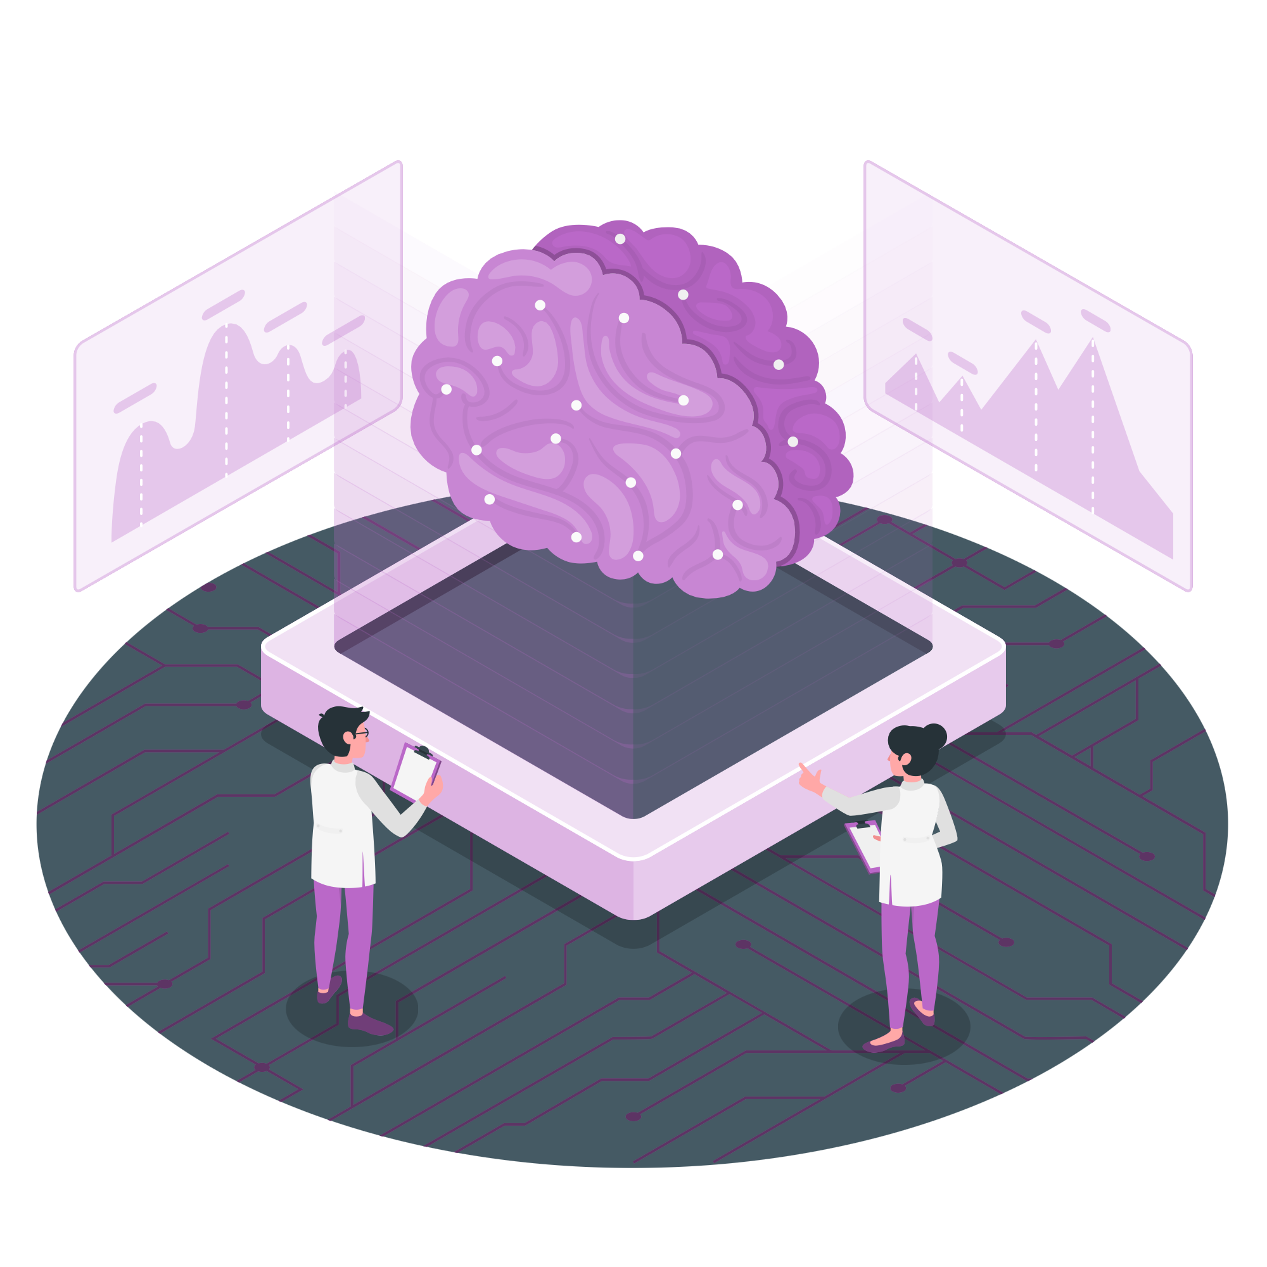
AI vs Machine learning
We often hear the term “AI” and “Machine Learning” thrown around as buzzwords or even used interchangeably
But what actually is their difference?
Artificial Intelligence
Computers being able to mimic human intelligence
Machine Learning
Algorithms whose performance increase with exposure to more data
Deep Learning
Simulates the human brain through multilayered “neurons” called artificial neural networks
Notes:
AI algorithms mimic human intelligence and behaviour, think of common tasks we do on a day to day basis that often gets overlooked, for example if I had a friend called James how do I know that a person is him if I end up bumping into him in the streets?
Well my brain has been trained to recognise their features like hair, skin color, eyes, face etc etc to associate with a particular person. i.e in the language of machines the input, and the output being the person’s name and everything I associate with that person.
There’s an example of facial recognition, what you use to unlock your phone
Autocorrection when I typed this script
Deep learning - Simulates the brain by passing data through multiple layers of a neural network, adjusting the connections between nodes based on the errors made during predictions, and iterating this process to improve accuracy and performance over time.

Slide 6
Traditional programming
Machine Learning
Data
Output
Program
Data
Learning
Program/Model
Output
Prediction
Data
Output
Program/Model
Notes:
Program/Algorithm
We can classify most machine learning algorithms as supervised or unsupervised
Does anyone have any questions at this stage?

Slide 7
Let’s have a look at a demo
Notes:
https://teachablemachine.withgoogle.com/train/image
GET RID

Slide 8
Supervised learning
Category of machine learning that uses labeled datasets to train algorithms then using that knowledge to make predictions or classifications on new, similar data.
Labeled Data
Prediction
Machine
Triangle
Labels
Circle
Circle
Triangle
Rectangle
Test data
Notes:
Online advertising, one of the most commercialised forms of machine learning
Most large ad platforms has an algorithm that collects information about you and the deduce how likely it is that you will click on a particular ad.
Foundation of recommender systems where videos, reels and ads are pop up on feed base on data.

Slide 9
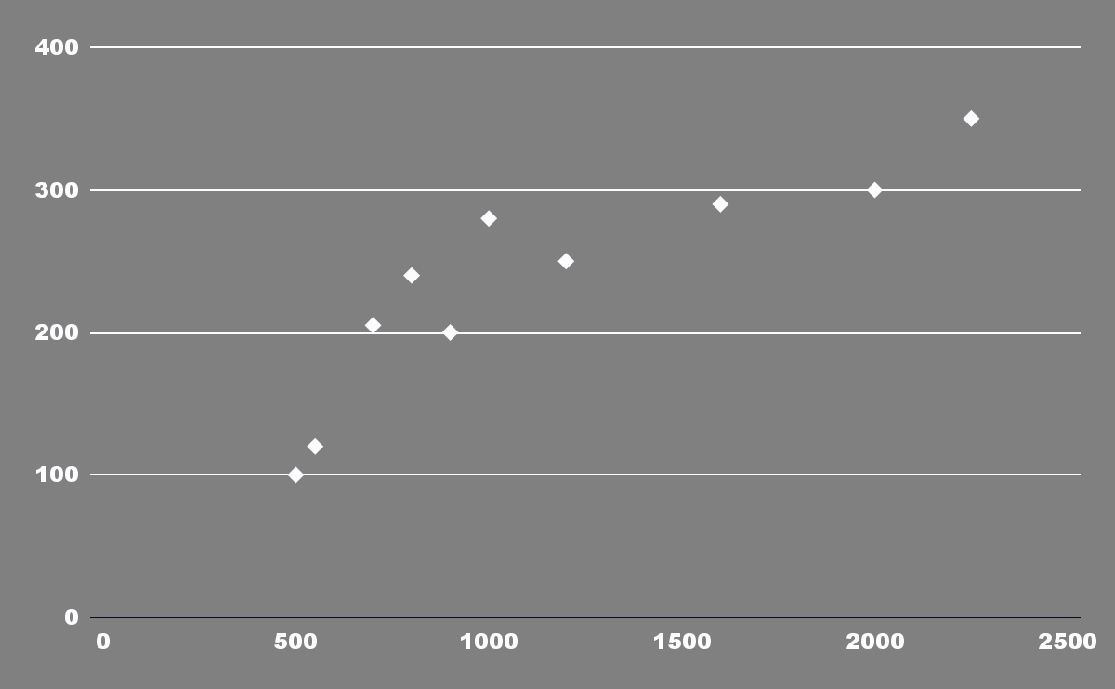
House price prediction
Notes:
You’re looking to buy a particular sized house in a particular neighborhood
Wanted an estimate of how much such house would cost.
Take the cost and size of other houses in the same neighborhood
Plot the points on a graph and use a regression algorithm to fit a model over the set of data
Give the model the size of the house you’re looking to purchase and the model will output a estimation of the cost
This is an example of a regression algorithm: Maps the relationship between two numerical variables, used for continuous output variables
EXTENSION: POLYNOMIAL REGRESSION
Talk about how we can train our algorithm to recognise what model is appropriate for a particular prob

Slide 10
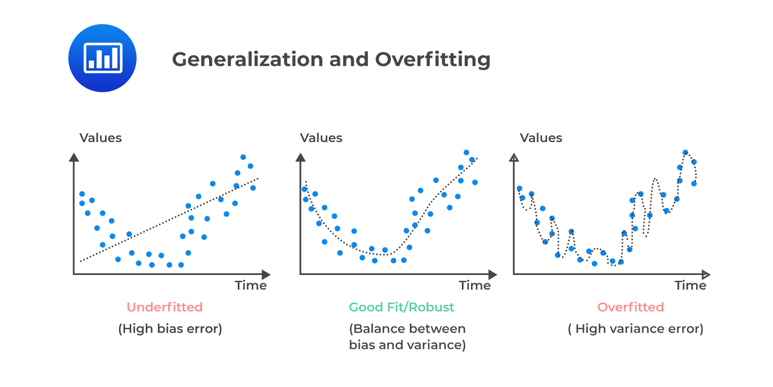
Problems: Regression
Underfitted
(High bias error)
Good Fit/Robust
(Balance between bias and variance)
Overfitted
(High variance error)
Notes:
Here we have 2 basic parameters to determine the effectiveness of our model
Underfit: Model too simple to capture the underlying structure of the data.
High bias, low variance, poor performance on training and new data
Overfit: Model too complex and learns underlying patterns in the training data + noise and random fluctuations.
High variance, low bias, excellent on training data, poor on new data as it fails to capture a general trend
Bias: Some aspects of a dataset are given more weight and/or representation than others
Variance: How sensitive the model is to small changes in the training data

Slide 11
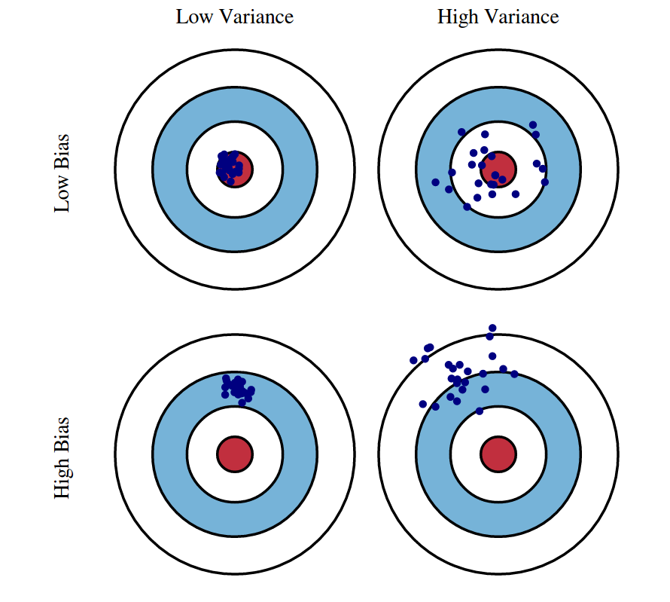
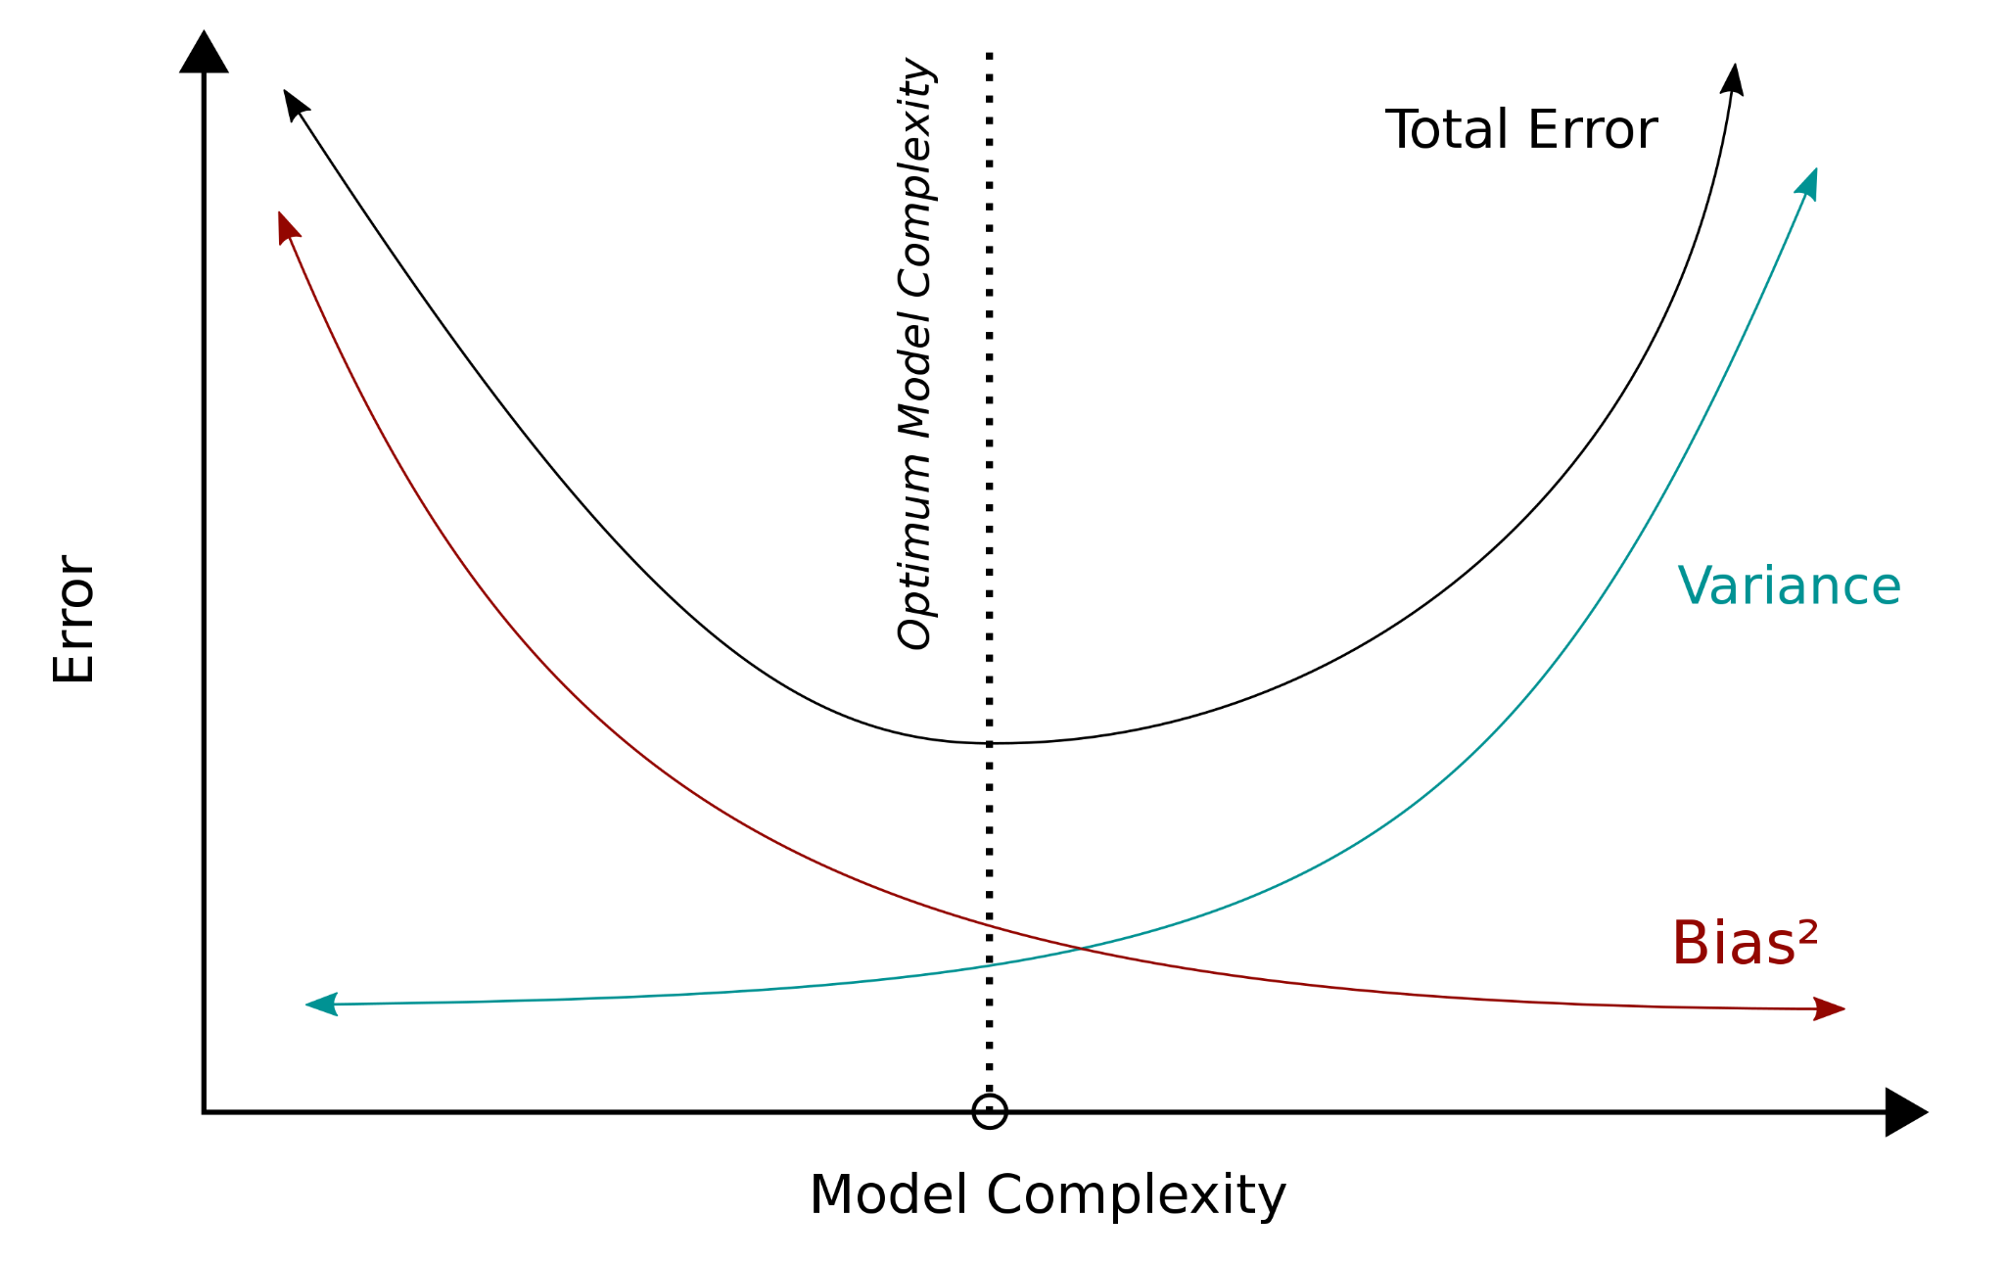
Bias-variance trade off
Notes:
Balance between these two sources of error that must be managed to build effective machine learning models.
Ideally, you want a model with low bias and low variance, but in practice, reducing one often increases the other.
Dw about the picture on the right if it doesn’t make sense
GET RID

Slide 12
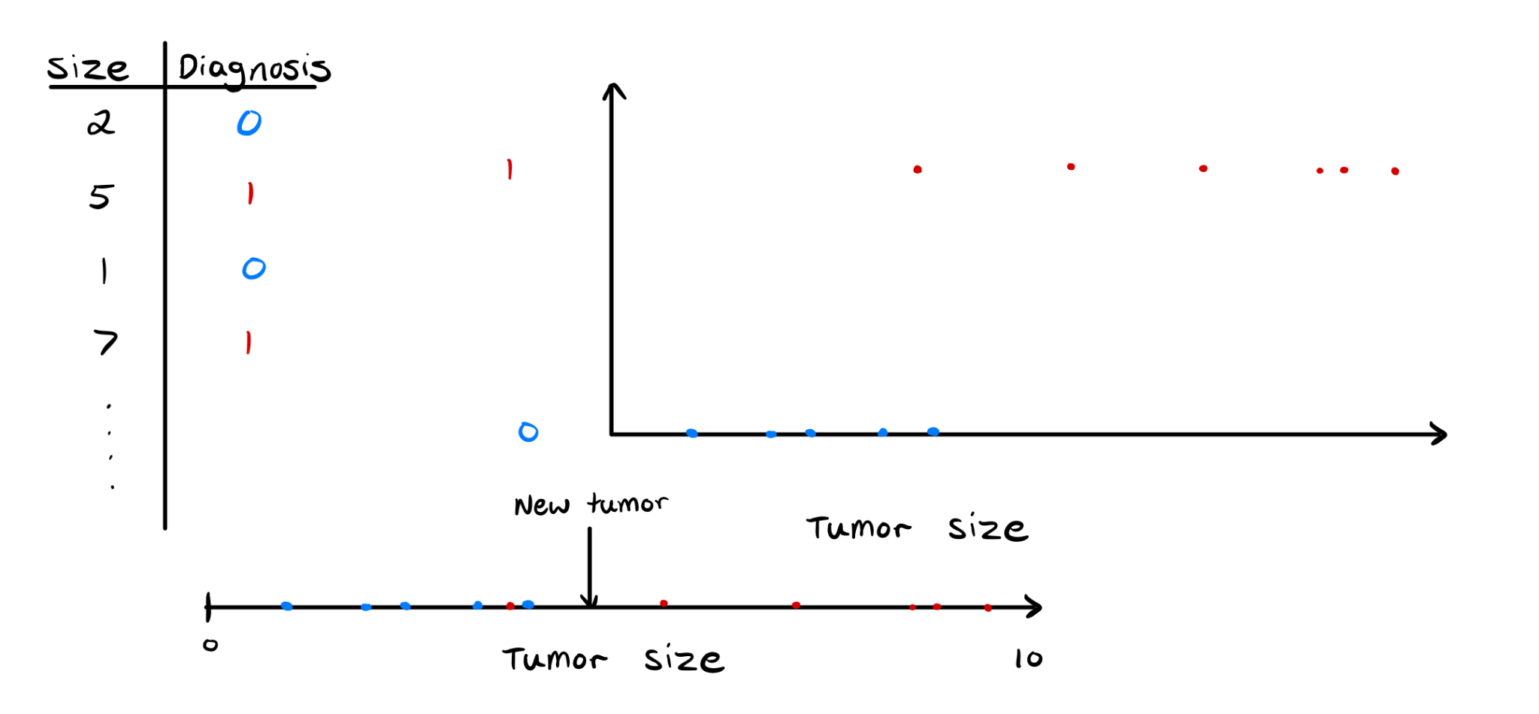
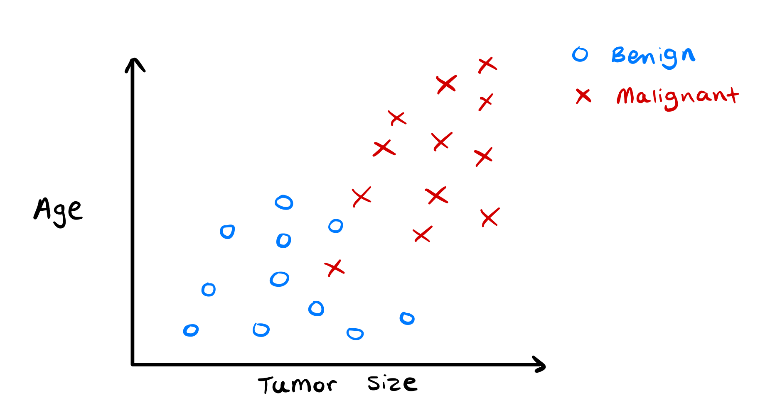
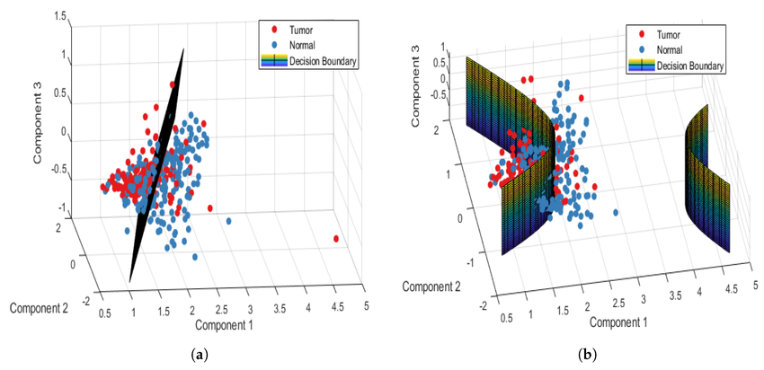
Cancer detection
Notes:
Suppose we are given a set of data representing tumour sizes and their classification, i.e benign or malignant
We wanted to draw a correlation between tumour sizes and malignant
Outputs categorical data (this is univariate categorical data)
Rare that classification problems are dependent on only 1 variable, suppose that cancer is also dependent on age
Algorithm constructs a decision boundary to help with classification.
What we have here is a binary classification algorithm
IRL problems are often much more complex and hence will sometimes require more complex decision boundaries (pic 3)

Slide 13
So how can we actually implement this in code?
Notes:
Alright so that’s enough theory for now, lets jump into how we might put this into code

Slide 14
Gradient Descent
Cost
Notes:
Gradient descent is a way for a machine learning model to learn and improve itself by gradually adjusting its parameters to minimize errors. Here's a simple breakdown:
Cost: How well the model’s prediction matches the actual data
Essentially here think of it as there is a particular weight and bias associated with each cost value
Basic Concept
1. Imagine a Valley: Think of gradient descent like finding the lowest point in a valley (the minimum of a function).
2. Steps: You start at a random point on the slope.
3. Downhill Movement: You take small steps downhill to get closer to the bottom.
4. Error Reduction: Each step aims to reduce the error (how far off your current position is from the lowest point).
Steps Involved
1. Initialize: Start at a random position.
2. Calculate Gradient: Determine the slope of the function at that point (gradient).
3. Update: Move in the direction of the negative slope (downhill) by a small amount (learning rate).
4. Repeat: Keep repeating this process until you reach the lowest point or get very close to it.
Visual Example
Imagine you are blindfolded and trying to find the bottom of a hill:
1. You feel the slope with your feet.
2. You take a step in the direction where the ground slopes downward.
3. You keep feeling the slope and taking steps until you can't go any lower.
Key Points
- Goal: Minimize the error by finding the lowest point of the error function.
- Adjustments: Make small adjustments based on the slope.
- Iterations: Repeat the process many times to get closer to the minimum.
In essence, gradient descent helps a model improve by continuously making small adjustments to reduce errors and get closer to the optimal solution.
GO BACK TO NOTEBOOK AND FINISH OFF SUPERVISED LEARNING

Slide 15
Unsupervised learning
Category of machine learning that trains models without labelled data to uncover hidden patterns & trends.
Unlabelled Data
Results
Machine
Notes:
We’re not necessarily asking the model to give us a correct answer from an input but instead we’re hoping to uncover a structure associated with the data

Slide 16
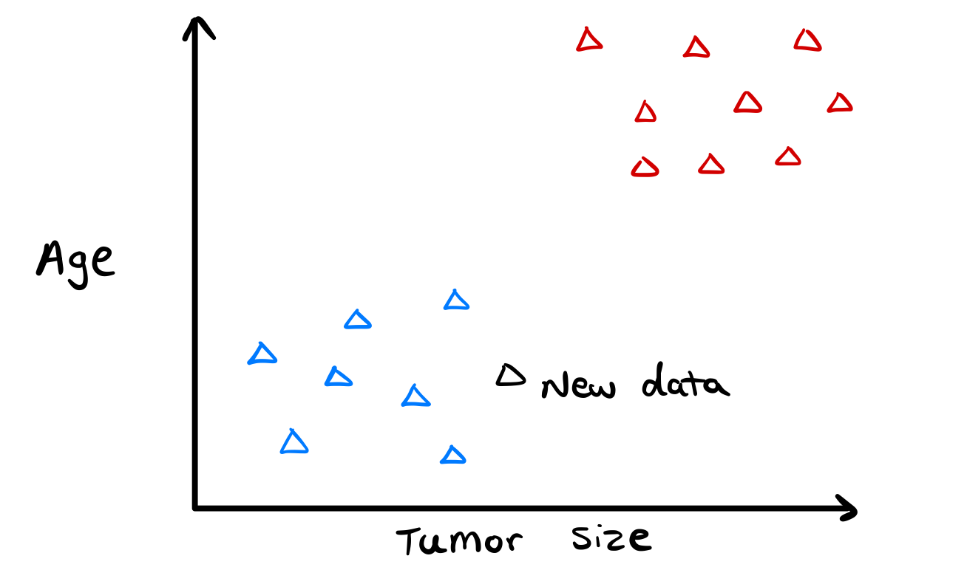
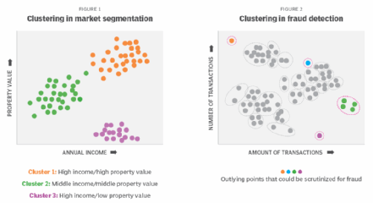
Unsupervised learning contd
Notes:
Suppose instead I still have several data points of patient’s tumor size and their age.
I don’t tell the model whether each tumor is malignant or not (train the model w just that)
Instead input a new patients age and tumor size and the model will place the new data in a “cluster”
Cluster is a collection of data points that are grouped together because they exhibit similar characteristics or properties.
But why do we care about this
ANOTHER APPLICATION: Credit/Data analyst at a bank
Use clustering to group transactions & identify outliers or unusual transactions that do not conform to the general pattern.
Fraud detection in financial transactions, network security

